Slide 1
Module Title: Basics of Anesthesia I Module Code: AnstM-3231 Instructors : sulaiman j& Ashenafi Module ECTS: 7ECTS
Pharmacology for anesthesia,Augest 2022

Slide 2
1.Basic principles of pharmacology Introduction Pharmacokinetics Pharmacodynamics

Slide 3
1.Introduction
Back 3000 BC in Mesopotamia, patients were anaesthetized by pressing the carotid arteries, .
The Egyptians were the first to apply snow to cause analgesia.
Chinese developed acupuncture as a special form of analgesia. In the ancient times,
surgical operations were performed cruel physical measures, such as suffocation, knocking-down, alcohol and tie and physical strainer

Slide 4
when modern anesthesia started ?
Prior to 1846 there was no way to provide anesthesia for surgical procedures Surgery was painful, bloody and dirty surgeons were praised for speed not skill.
Dr.Horace wells (Dentist) 1844 noticed effect of N2O at laughing gas party and use it for tooth extraction without pain,

Slide 5
In January 1845 demonstrate N2O for surgical procedure at Massachusetts general hospital but fail in front of many physicians and ashamed and commute succeed.
Dr.willian Morton demonstrate effective anesthesia for neck tumor excision using ether anesthesia./obstetric anesthesia

Slide 6
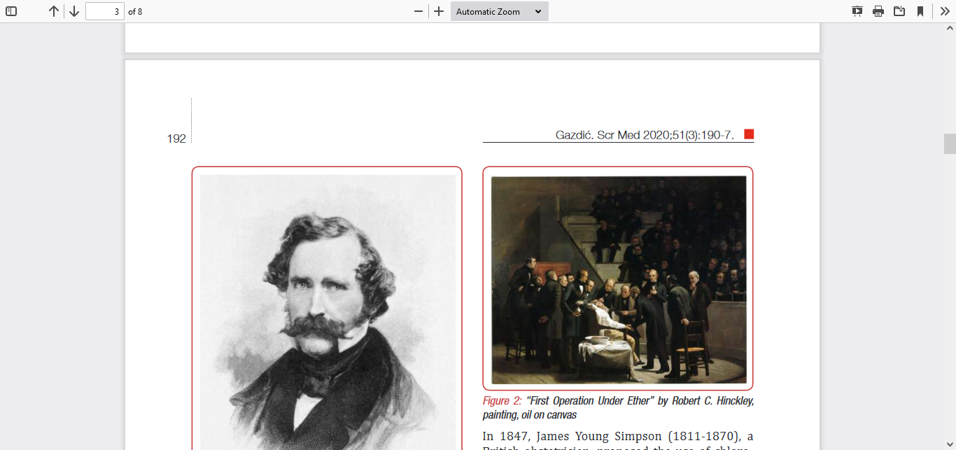

Slide 7
Some scholars explain Anesthesiology as applied pharmacology.
The clinical practice of anesthesiology is directly connected to the science of clinical pharmacology no clinical medical specialty needs pharmacology as anesthetist

Slide 8
what pharmacokinetics/dynamics?
In general what the body does to a drug is called pharmacokinetics
What a drug does to the body is termed as pharmacodynamics.

Slide 9
Drug Passage across the Cell Membrane
Many drugs need to pass through one or more cell membranes to reach their site of action.
A common feature of all cell membranes is a phospholipid bilayer, arranged with the hydrophilic heads on the outside and the lipophilic chains facing inwards. This gives a sandwich effect,

Slide 10
with two hydrophilic layers surrounding the central hydrophobic one. Spanning this bilayer or attached to the outer or inner leaflets are glycoproteins, which may act as ion channels, receptors, intermediate messengers (G-proteins,G-proteine couple receptors) or enzymes etc

Slide 11
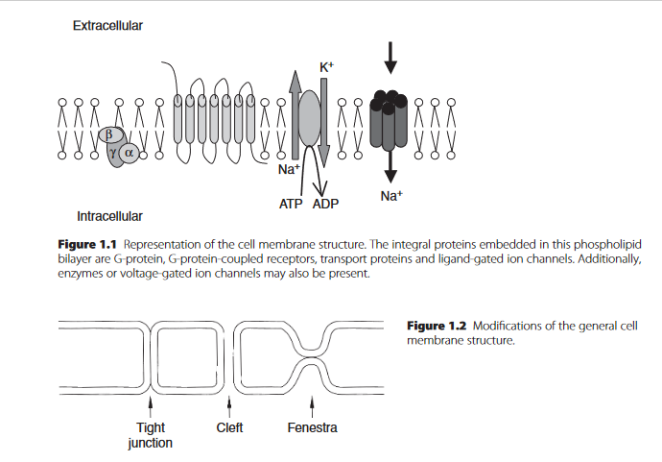
Methods of drug crossing to cytoplasm

Slide 12
Methods of Crossing the Cell Membrane
Passive Diffusion This is the commonest method for crossing the cell membrane. Drug molecules move down a concentration gradient, from an area of high concentration to one of low concentration and the process requires no energy to proceed.

Slide 13
Many drugs are weak acids or weak bases and can exist in either the unionized or ionized form, depending on the pH. The unionized form of a drug is lipid-soluble and diffuses easily by dissolution in the lipid bilayer. Thus the rate at which transfer occurs depends on the pKa of the drug in question.

Slide 14
In addition, there are specialized ion channels in the membrane that allow intermittent passive movement of selected ions down a concentration gradient

Slide 15
Ion channels may have their permeability altered by endogenous compounds or by drugs.
Local anesthetics bind to the internal surface of the fast Na+ ion channel and prevent the conformational change required for activation,
while non depolarising muscle relaxants
prevent receptor activation by competitively inhibiting the binding of ACh to its receptor site.

Slide 16
Facilitated Diffusion
Facilitated diffusion refers to the process where molecules combine with membrane-bound carrier proteins to cross the membrane. The rate of diffusion of the molecule–protein complex is still down a concentration gradient Transfer is faster than simple diffusion.

Slide 17
An example of this is the absorption of glucose, a highly polar molecule, which would be relatively slow if it occurred by diffusion alone.
There are several transport proteins responsible for facilitated glucose diffusion; they belong to the solute carrier (SLC) family 2 .

Slide 18
Active Transport
Active transport is an energy-requiring process. The molecule is transported against its concentration gradient by a molecular pump, which requires energy to function.

Slide 19
Na+/K+ ATPase is an example of primary active transport (antiport) The Na+/amino acid (symport) the energy in the high-energy phosphate bond is lost as the molecule is hydrolyzed, with concurrent ion transport against the respective concentration gradients

Slide 20
Pinocytosis
Pinocytosis is the process by which an area of the cell membrane invaginates around the target molecule and moves it into the cell. The molecule may then be released into the cell or may remain in the vacuole so created, until the reverse process occurs on the opposite side of the cell , usually for large molecules.

Slide 21
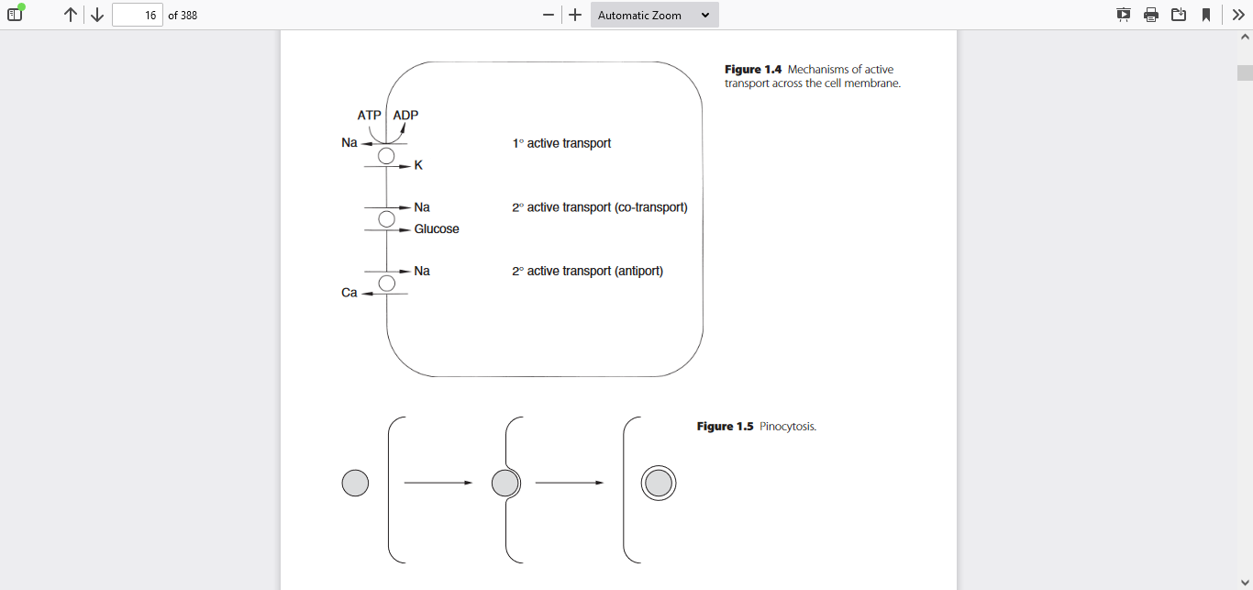

Slide 22
Factors Influencing the Rate of Diffusion
Molecular Size
Concentration Gradient
Ionization The lipophilic nature of the cell membrane only permits the passage of the uncharged fraction of any drug
Lipid Solubility
Protein Binding

Slide 23
The lipophilic nature of the cell membrane only permits the passage of the uncharged fraction of any drug.
The pKa is the pH at which 50% of the drug molecules are ionized thus the concentrations of ionized and unionized portions are equal.

Slide 24
Only the unbound fraction of any drug in plasma is free to cross the cell membrane; from binding protein.
Albumin binds neutral or acidic drugs (e.g. barbiturates)
Globulins bind basic drugs (e.g.morphine).

Slide 25
Blood Brain Barrier
The blood–brain barrier (BBB) is an anatomical and functional barrier between the circulation and the CNS.Active transport and facilitated diffusion are the predominant methods of molecular transfer, which in health is tightly controlled.

Slide 26
Glucose and hormones, such as insulin, cross by active carrier transport, while only lipid-soluble, low molecular weight drugs can cross by simple diffusion ionized drugs is limited by pericapillary glial cells and endothelial cell tight junctions

Slide 27
Thus inhaled and intravenous anesthetics can cross readily whereas the larger, polar muscle relaxants cannot and have no central effect. Similarly, glycopyrrolate has a quaternary, charged nitrogen and does not cross the BBB readily.

Slide 28
PHARMACOKINETICS
Pharmacokinetics defines the relationships among drug dosing, drug concentration in body fluids and tissues and time.
It consists of four linked processes: absorption,distribution,biotransformation,(metabolism) and excretion.

Slide 29
Absorption
Absorption defines the processes by which a drug moves from the site of administration to the bloodstream. There are many possible routes of drug administration: oral, sublingual, rectal, inhalational, transdermal, transmucosal, subcutaneous, intramuscular,perineural, peridural, intrathecal, and intravenous

Slide 30
Absorption is influenced by the physical characteristics of the drug (solubility,pKa, diluents, binders, and formulation), dose, the site of (eg, gut,lung, skin, muscle), and in some cases (eg, perineural or subcutaneous administration of local anesthetics) by additives such as epinephrine

Slide 31
An acidic environment (stomach) favors the absorption of acidic drugs, whereas a more alkaline environment (intestine) favors basic drugs.

Slide 32
Acidic drugs (e.g. aspirin) are unionized in the highly acidic medium of the stomach and therefore are absorbed more rapidly than basic drugs. Although weak bases (e.g. propranolol) are ionized in the stomach, they are relatively unionized in the duodenum, so are absorbed from this site. The salts of permanently charged drugs (e.g. vecuronium, glycopyrrolate) remain ionized at all times and are therefore not absorbed from the GI tract

Slide 33
Bioavailability
Bioavailability is generally defined as the fraction of a drug dose reaching the systemic circulation, compared with the same dose given intravenously.
In general, the oral route has the lowest bioavailability of any route of administration.

Slide 34
Intravenous administration provides a direct, and therefore more reliable, route of systemic drug delivery. No absorption is required, so plasma levels are independent of such factors as gastrointestinal (GI)

Slide 35
Factors Influencing Bioavailability
1.Pharmaceutical preparation
2.Patient factors
3.Pharmacokinetic interactions and first-pass metabolism – drugs absorbed from the gut
with some exception pass via the portal vein to the liver where they may be subject to first-pass metabolism. Metabolism at either the gut wall or liver will reduce the amount reaching circulation

Slide 36
As an example nitroglycerin undergoes extensive first-pass hepatic metabolism before reaching the systemic circulation so reduce the amount reaching circulation.

Slide 37
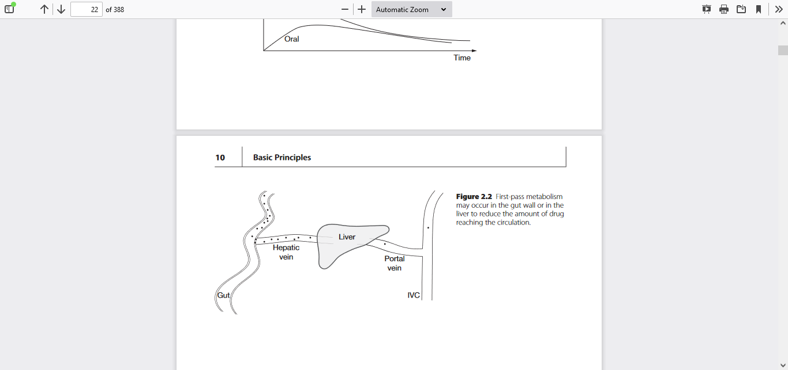

Slide 38
Distribution
Once absorbed, a drug is distributed by the bloodstream throughout the body.
Highly perfused organs (so-called vessel-rich group) receive a disproportionate fraction of the cardiac output Therefore, these tissues receive a disproportionate amount of drug in the first minutes following drug admin…

Slide 39
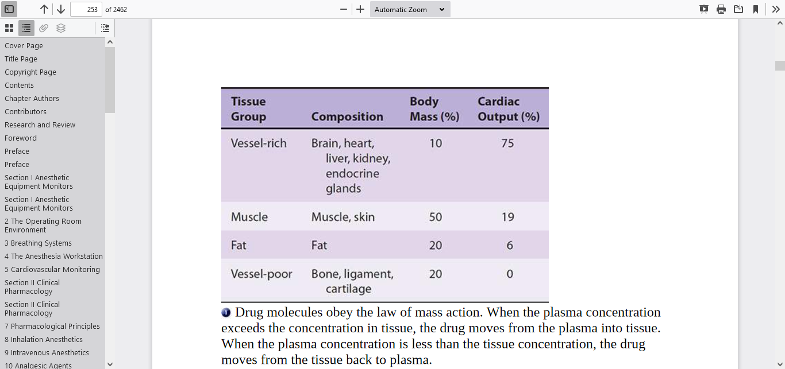
Tissue group composition, relative body mass, and percentageof cardiac output

Slide 40
drug concentration in an organ is determined by that organ’s perfusion and the relative drug solubility in the organ compared with Blood Molecules in blood are either free or bound to plasma proteins and lipids. The free concentration equilibrates between organs and tissues. However, the equilibration between bound and unbound molecules is instantaneous

Slide 41
Lipophilic molecules can readily transfer between the blood and organs.
Charged molecules are able to pass in small quantities into most organs.

Slide 42
The redistribution phase (from each tissue) follows this moment of equilibration. During redistribution, drug returns from tissues back into the plasma. This return of drug back to the plasma slows the rate of decline in plasma drug concentration. Redistribution generally delays emergence as drug returns from tissue reservoirs to the plasma for many hours.

Slide 43
Distribution generally contributes to rapid emergence by removing drug from the plasma for many minutes following administration of a bolus of an induction agent. Following prolonged infusions of lipophilic anesthetic drugs, redistribution generally delays emergence as drug returns from tissue reservoirs to the plasma for many hours.

Slide 44
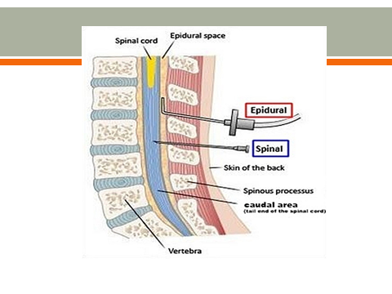
The epidural/intrathecal
The epidural/ intrathecal route is used to analgesia and anesthesia. Epidural local anesthetics, opioids, ketamine,steroied and clonidine have all been used to treat acute pain

Slide 45
What is the cause of low protine ?
Low plasma albumin can caused by
Kidney disease and liver disease,
chronic congestive heart failure.
Malignancies/ burns>20%
acute infective or inflammatory process
propofol, which is administered with its own binding molecules (the lipid in the emulsion).not dependent on protein binding

Slide 46
Drug Distribution to the Fetus
The placental membrane is more readily crossed by lipid-soluble than polar molecules. It is much less selective than the BBB and even molecules with only moderate lipid solubility appear to cross with relative ease and significant quantities may appear in cord blood.

Slide 47
Drugs during Pregnancy
Because of significant human teratogenicity. Wherever possible drug therapy should be avoided throughout pregnancy; if treatment is essential drugs with a long history of safety should be selected stilboestrol taken during pregnancy predisposes female offspring to ovarian ca.
what is Thalidomide disaster?

Slide 48
the risk of not taking medication outweighs the theoretical or actual risk of teratogenicity.
Example epilepsy treatment

Slide 49
Drugs at the Time of Birth
The newborn may have anaesthetic or analgesic drugs in their circulation depending on the type of analgesia for labour and whether delivery was operative. Drugs with a low molecular
weight that are lipid-soluble will be present in higher concentrations than large polar molecules.

Slide 50
Pethidine is used commonly for analgesia during labour. The high lipid solubility of pethidine enables significant amounts to cross the placenta and reach the fetus. It is metabolized to norpethidine, which is less lipid-soluble and can accumulate in the fetus,levels peaking about 4 hours after the initial maternal IM dose.

Slide 51
Metabolism
Biotransformation is the chemical process by which the drug molecule is altered in the body. The liver is the primary organ of metabolism for most drugs.
One exception is esters, which undergo hydrolysis in the plasma or tissues. The end products of biotransformation are often inactive and water soluble. Water solubility allows excretion by the kidneys.

Slide 52
Metabolic biotransformation is frequently divided into phase I and phase II reactions. Phase I reactions convert a parent compound into more polar metabolites through oxidation, reduction, or hydrolysis.
Phase II reactions couple (conjugate) a parent drug or a phase I metabolite with an endogenous substrate (eg, glucuronic acid) to form water-soluble metabolites that can be eliminated in the urine or stool. Although this is usually a sequential process,

Slide 53
Hepatic clearance is the volume of blood or plasma cleared of drug per unit of time. The units of clearance are units of flow: volume per unit time. Clearance may be expressed in milliliters per minute or liters per hour,
For most drugs, only a fraction of the drug that enters the liver is removed. The fraction removed is called the extraction ratio.

Slide 54
Many drugs have low hepatic extraction ratios and are slowly cleared by the liver. For these drugs, the rate-limiting step is not the flow of blood to the liver,but rather the metabolic capacity of the liver itself.

Slide 55
While metabolism usually reduces the activity of a drug, activity may be designed to increase;
A prodrug is defined as a drug that has no inherent activity before metabolism but that is converted by the body to an active moiety example enalapril (metabolised to enalaprilat)

Slide 56
Metabolites may also have equivalent activity to the parent compound, in which case duration of action is not related to plasma levels of the parent drug.
In general, metabolism produces a more polar (water soluble) molecule that can be excreted in the bile or urine – the chief routes of drug excretion ,

Slide 57
Many phase I reactions(non synthesis), particularly oxidative pathways, occur in the liver due to a non-specific mixed-function oxidase system in the endoplasmic reticulum. These enzymes form the cytochrome P450 system.

Slide 58
This cytochrome system is not unique to the liver; these enzymes are also found in gut mucosa, lung, brain and kidney. Methoxyflurane is metabolized by CYP2E1 in the kidney, generating a high local concentration of fluoride ions, which was the cause of renal failure.

Slide 59
The enzymes of the cytochrome P450 system are classified into families and subfamilies by their degree of shared amino acid sequences Families are labelled CYP1, CYP2, and so on

Slide 60
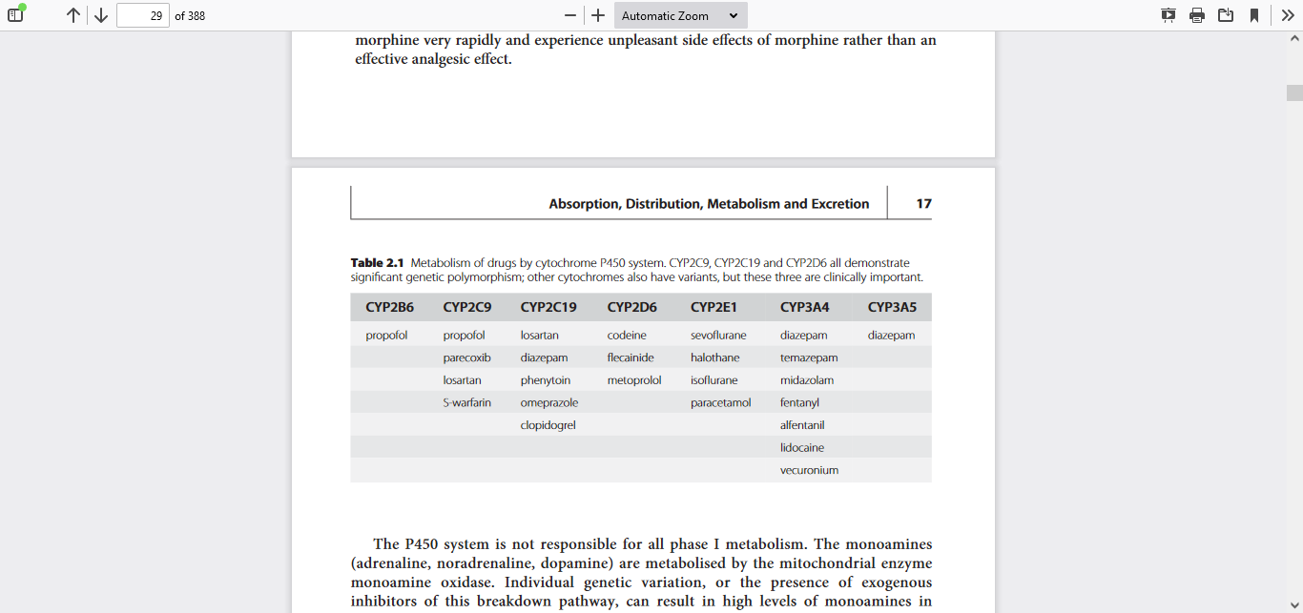

Slide 61
The P450 system is not responsible for all phase I metabolism. The monoamines (adrenaline, noradrenaline, dopamine) are metabolized by the mitochondrial enzyme
monoamine oxidase. Individual genetic variation, or the presence of exogenous inhibitors of this breakdown pathway, can result in high levels of monoamines in the circulation, with severe cardiovascular effects

Slide 62
In addition, some metabolic processes take place in the plasma: cisatracurium breaks down spontaneously in a pH& temperature dependent manner – Hofmann degradation and suxamethonium is hydrolyzed by plasma cholinesterase.

Slide 63
Phase II (Conjugation or Synthetic)
• Glucuronidation (e.g. morphine, propofol)
• Sulfation (e.g. quinol metabolite of propofol)
• Acetylation (e.g. ioniazid, sulfonamides)
• Methylation (e.g. catechols, noradrenaline).
In liver failure, phase I reactions are generally affected before phase II, so drugs with a predominantly phase II metabolism, such as lorazepam, are less affected

Slide 64
Genetic Polymorphism
There are inherited differences in enzyme structure that alter the way drugs are metabolized in the body. The genetic polymorphisms of particular relevance to anaesthesia are those of plasma cholinesterase,

Slide 65
Enzyme Inhibition and Induction
Some drugs induce the activity of the hepatic microsomal enzymes. The rate of metabolism of the enzyme-inducing drug as well as other drugs is increased and may lead to
reduced plasma levels. some drugs like cimetidine inhibit the activity of hepatic microsomal enzymes and may result in increased plasma levels.

Slide 66
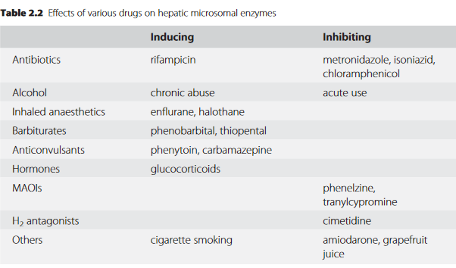

Slide 67
Excretion
Elimination refers to the processes of removal of the drug from the plasma and includes distribution and metabolism, while excretion refers to the removal of drug from the body.
The chief sites of excretion are in the urine , bile and for the volatile anesthetic agents is via the lungs; however, metabolites are detectable in urine. Elimination half-time is the time required for the drug concentration to fall by 50%.

Slide 68
ENTEROHEPATIC RECIRCULATION is when drugs metabolites excreted in bile are subsequently reabsorbed in the intestine and converted back to the parent drug.
For example, lorazepam is converted by the liver to lorazepam glucuronide. In the intestine, β glucuronidase breaks the ester linkage, converting lorazepam glucuronide back to lorazepam.

Slide 69
high molecular weight compounds (>30,000 Da) are not filtered or secreted by the kidney and are therefore preferentially excreted in the bile.
A significant fraction of a drug carrying a permanent charge such as pancuronium, may be excreted unchanged in urine

Slide 70
Renal Excretion Filtration at the Glomerulus Small, non-protein-bound, poorly lipid-soluble but readily water-soluble drugs are excreted into the glomerular ultra filtrate.

Slide 71
Drug secretion may also be inhibited, for example, probenecid blocks the secretion of penicillin.
Biliary Excretion
High molecular weight compounds, such as the steroid-based muscle relaxants, are excreted in bile

Slide 72
Effect of Disease
Patient’s CREATININE CLEARANCE is very helpful in estimating the dose of drug in patient with renal disease
.

Slide 73
Mechanisms of Drug Action
how drugs act ?
Drugs may act in a number of ways to exert their effect. By acting on body proteins/enzymes, voltage-gated ion channels and receptors etc.

Slide 74
The antacids exert their effect by neutralizing gastric acid.
The chelating agents are used to reduce the concentration of certain metallic ions within the body.
WHAT CHELATING FOOD DO YOU KNOW?
.

Slide 75
The reversal agent sugammadex selectively chelates rocuronium and reversal is possible from deeper levels of neuromuscular block than can be effected with the anticholinesterases

Slide 76
Enzymes
most drugs that interact with enzymes are inhibitors. Enzyme inhibition may be competitive (edrophonium/anticholinesterase),
omeprazole for the Na+/H+ ATPase).
Angiotensin-converting enzyme (ACE) inhibitors such as ramipril prevent the conversion of angiotensin I to II.

Slide 77
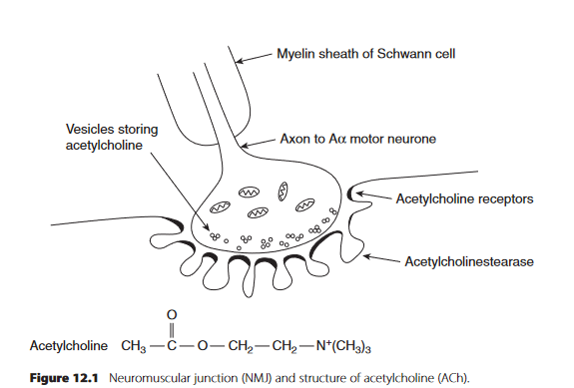

Slide 78
Voltage-gated Ion Channels
Several groups of drugs have specific blocking
actions at these ion channels as L/anesthesia
calcium channel blocking agents act on vascular smooth muscle ion channels and anti-arrhythmic agents block myocardial ion channel

Slide 79
Receptors
A receptor is a protein, often integral to a membrane, containing a region to which a natural ligand binds specifically to bring about a response.
The drug effect is governed by the fraction of receptors that are occupied by an agonist..

Slide 80
A drug acting at a receptor binds to a recognition site where it may elicit an effect (an agonist).
Pharmacological antagonists reverse the effects of the agonist but do not otherwise exert an effect of their own.

Slide 81
Receptor Agonism
Full Agonists are drugs able to generate a maximal response from a receptor.
The ED50 is the dose producing 50% of the maximum response.

Slide 82
Partial Agonists
It occupies receptors, but produces a submaximal effect compared with the full agonis
Inverse Agonists It is possible for a drug to bind and exert an effect opposite to that of the endogenous agonist. Such a drug is termed an inverse agonis

Slide 83
Receptor Antagonism
Antagonists exhibit affinity but no intrinsic activity.
Reversible antagonists may either be competitive, noncompetitive.
Examples of competitive inhibition include,
β-blockers competing with noradrenaline at β-adrenergic receptor sites in the heart.

Slide 84
Irreversible
irreversible actions on receptors. Phenoxybenzamine irreversibly binds to and antagonises the effects of catecholamine's at α-adrenoreceptors.

Slide 85
Spare Receptors
The neuromuscular junction contains acetylcholine (ACh) receptors, which when occupied by ACh cause depolarization of the motor end plate. However, only a fraction of
these receptors need to be occupied to produce a maximal pharmacological effect., spare receptor help in case of toxins.

Slide 86
After spinal cord injury nicotinic acetylcholine receptors are not stimulated by impulses in motor nerves and proliferate in denervated muscle. This can lead to exaggerated responses (including hyperkalemia) to succinylcholine.

Slide 87
Tachyphylax is is defined as a rapid decrease in response to repeated doses over a short time period. The most common mechanism is the decrease of stores of a transmitter before
Resynthesize can take place. An example is the diminishing response to repeated doses of ephedrine, an indirectly acting sympathomimetic amine, caused by the depletion of noradrenaline

Slide 88
Tolerance refers to the phenomenon whereby larger doses are required to produce the same pharmacological effect, such as occurs in chronic opioid use or abuse. This reflects an altered Drug Action sensitivity of the receptors of the CNS to opioids – the mechanism may be a reduction of receptor density or a reduction of receptor affinity

Slide 89
Desensitization refers to a chronic loss of response over a longer period and may be caused by a structural change in receptor morphology or by an absolute loss of receptor numbers.
Drug Interaction-occur when one drug modifies the action of another. insulin may be denatured if prepared in solutions of dextrose and may, therefore, lose its pharmacological effect.

Slide 90
Drugs that decrease cardiac output (such as β-blockers) ↓the flow of blood carrying absorbed drug to its site of action. E.g. Fasciculation
One common direct interaction that may be overlooked is that between phenylephrine and α1-adrenergic blockers used for the treatment of benign prostatic hyperplasia.
No respond to anesthesia related ↓ B/P by phenylephrine

Slide 91
The interaction between monoamine oxidase inhibitors (MAOI) and pethidine is a classic example of an interaction. The increase in noradrenaline caused by MAOIs is potentiated when re-uptake is inhibited by pethidine.

Slide 92
Summation
Summation refers to the action of the two drugs being additive, with each drug having an
independent action in the absence of the other. Therefore, the co-administration of midazolam and propofol at the induction of anaesthesia reduces the amount of propofol necessary for the same an aesthetic effect.

Slide 93
Potentiation
Potentiation results from an interaction between two drugs in which one drug has no independent action of its own, yet their combined effect is greater than that of the active drug alone. Ex. probenecid reduces the renal excretion of penicillin, such that the effect of a dose of penicillin is enhanced without itself having antibiotic activity.

Slide 94
Synergism
Synergy occurs when the combined action of two drugs is greater than would be expected from purely an additive effect. Often this is because the drugs exert similar effects, but through different mechanisms. Propofol and remifentanil act synergistically when used to maintain anaesthesia.

Slide 95
Measurement of Pharmacokinetic Parameters
Volume of Distribution
Volume of distribution (Vd) is defined as the apparent volume into which a drug disperses in order to produce the observed plasma concentration.

Slide 96
PHARMACODYNAMICS
Pharmacodynamics, the study of how drugs affect the body, involves the concepts of potency, efficacy, and therapeutic window.
The fundamental pharmacodynamics concepts are captured in the relationship between exposure to a drug and physiological response to the drug, often called the dose–response or concentration–response relationship.

Slide 97
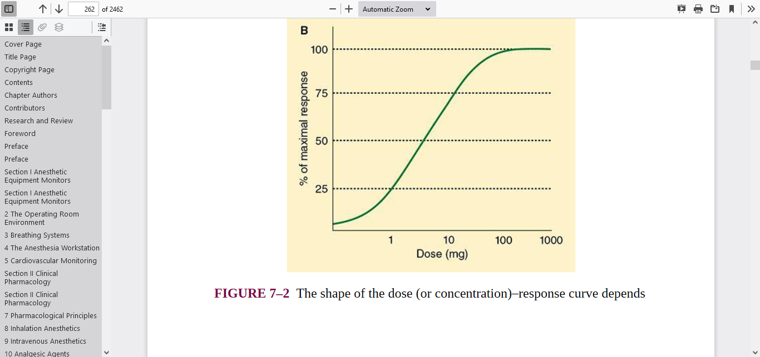
As the body is exposed to an ↑ amount of a drug, the response to the drug similarly increases, typically up to a maximal value

